Slide 1

NSF Grant Super Computer Usage Modelling
Kaggle Competition
David Cavanaugh
Math 8670: Advanced Statistical Machine Learning
December 7, 2021

Slide 2
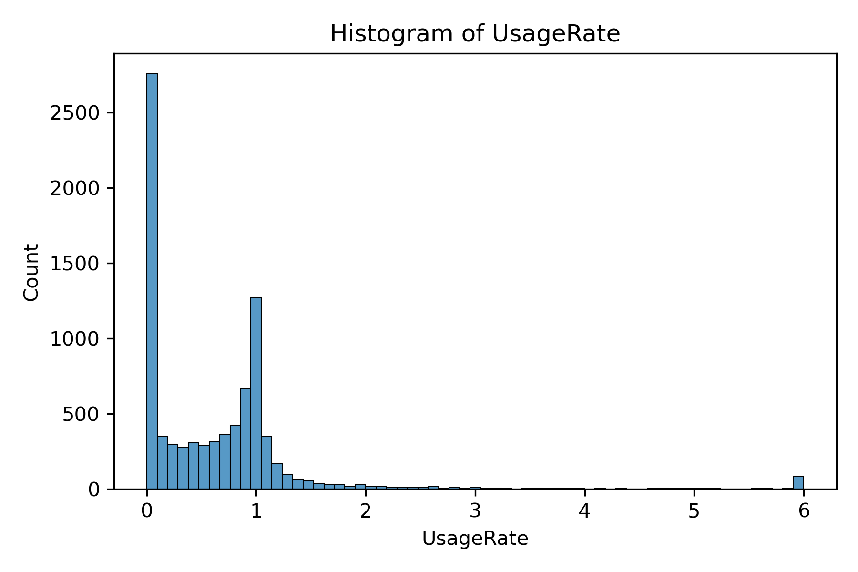
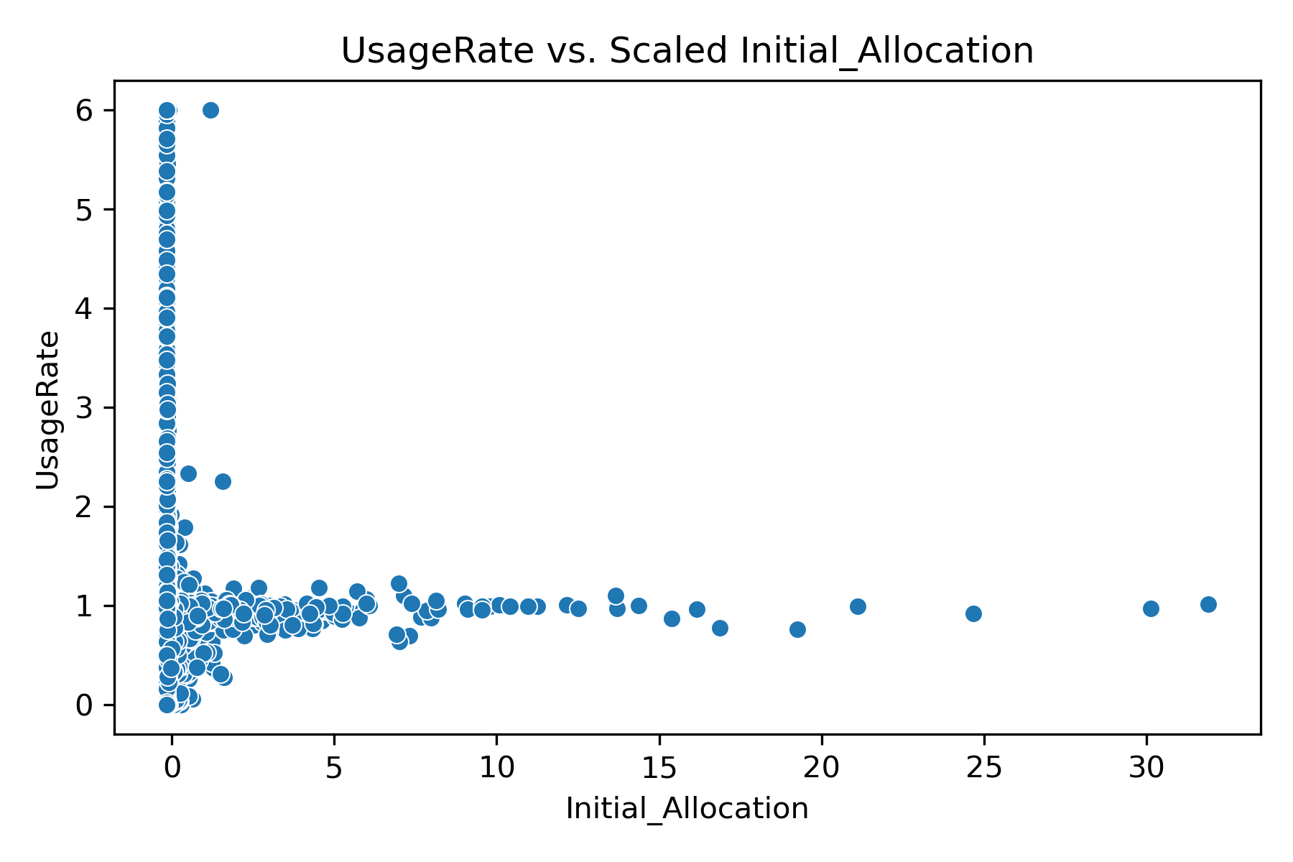
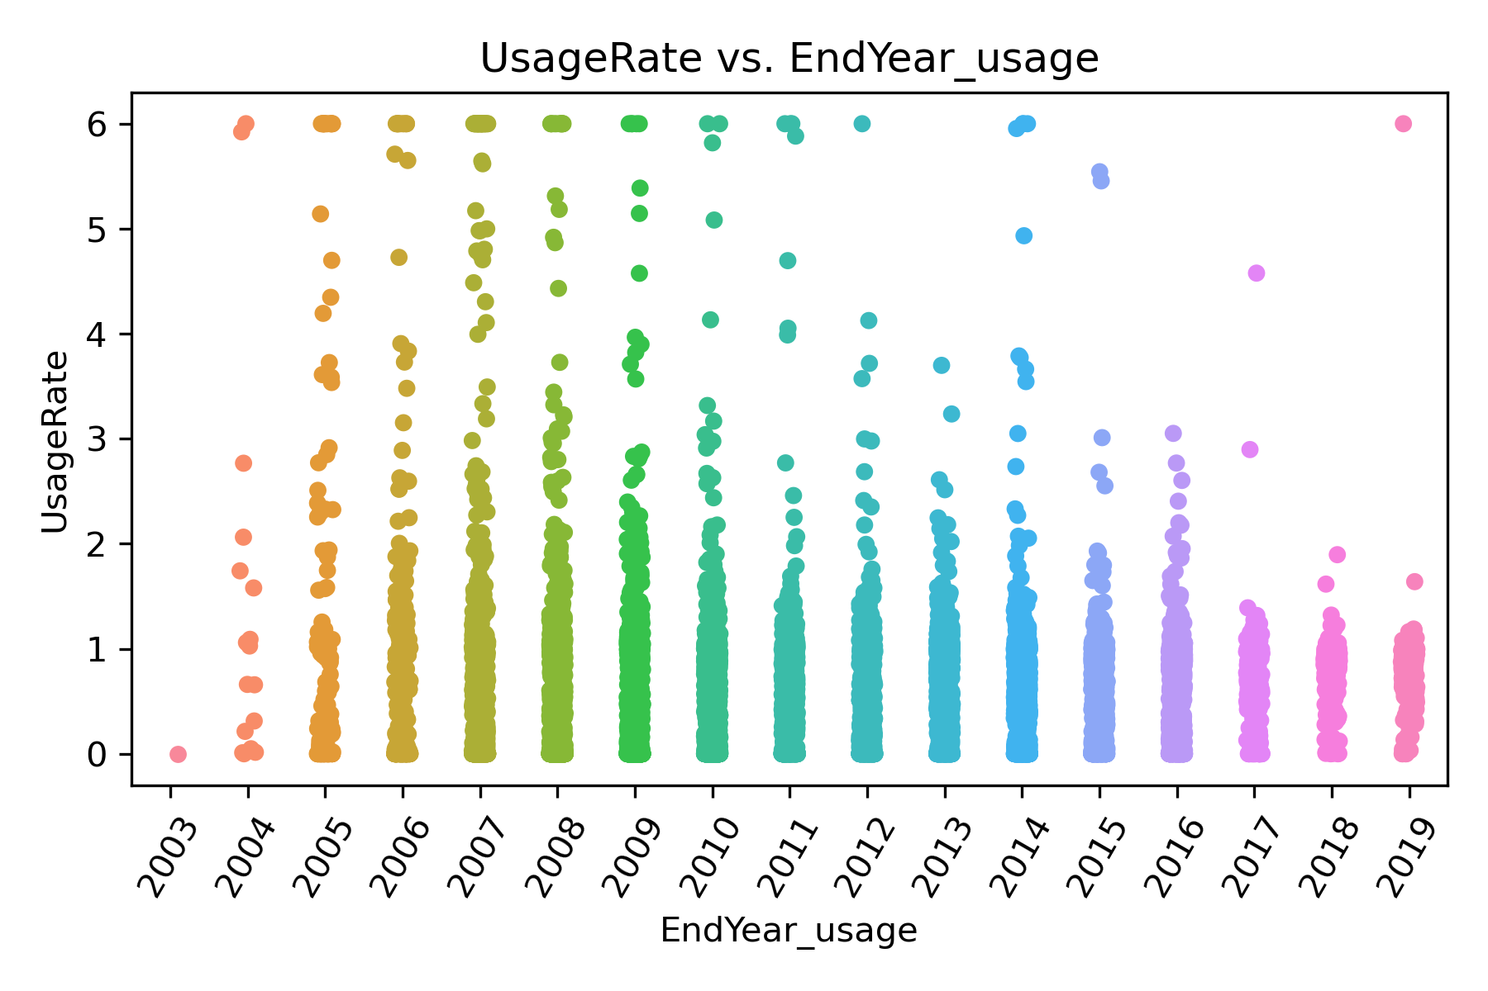
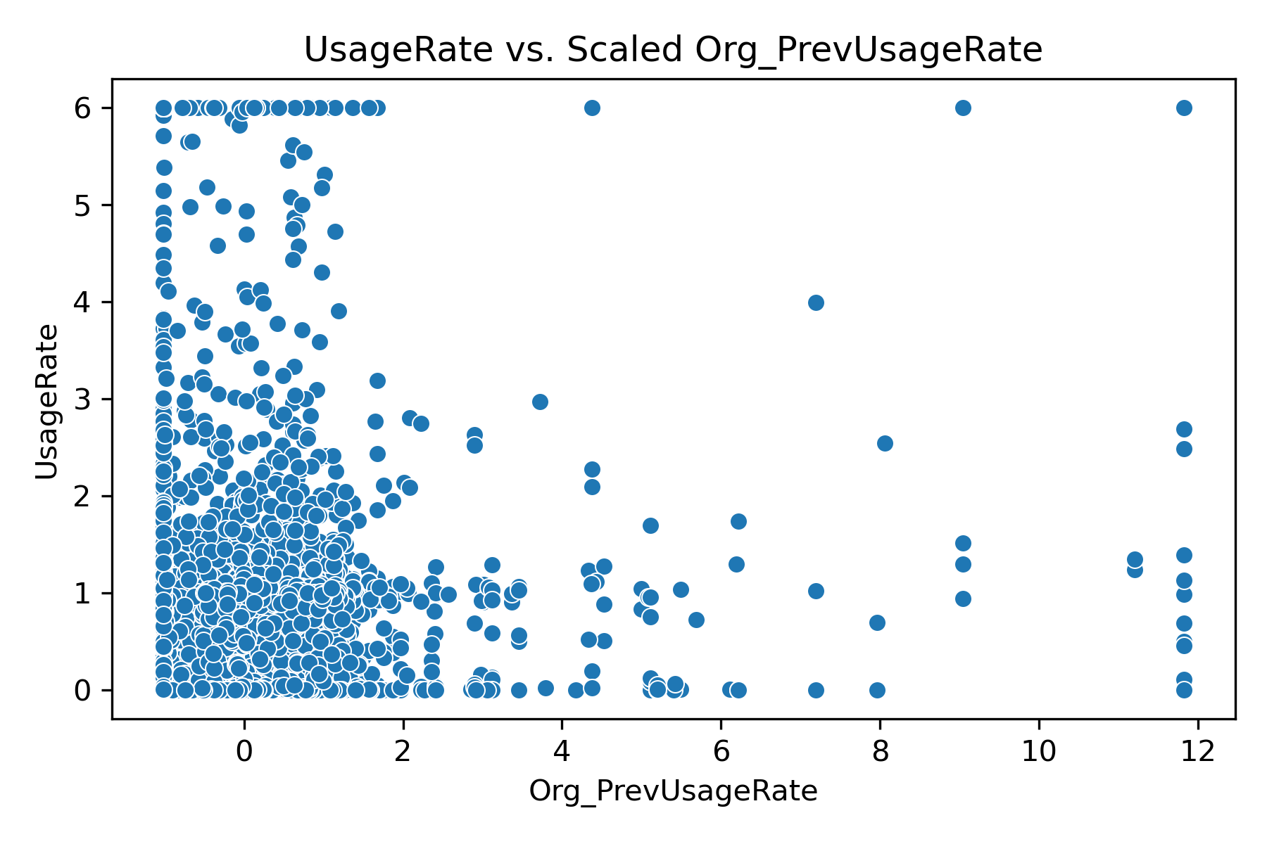
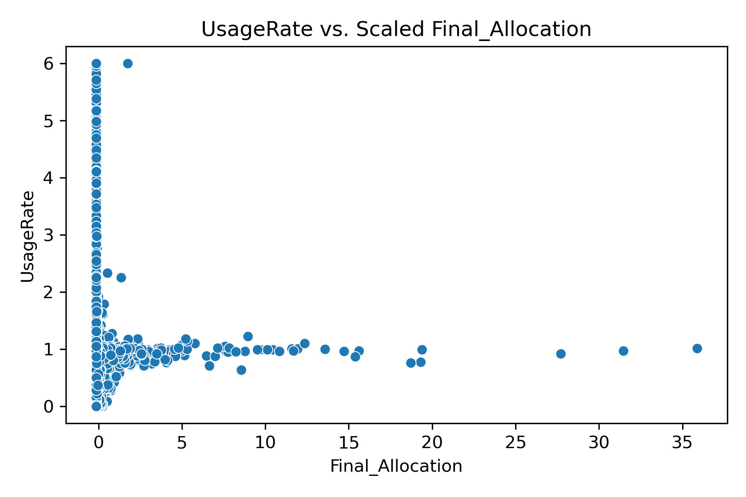
Data Visualization
UsageRate
Target variable
Input Variables
Initial Allocation
Final Allocation
EndYear_usage
Org_PrevUsageRate

Slide 3
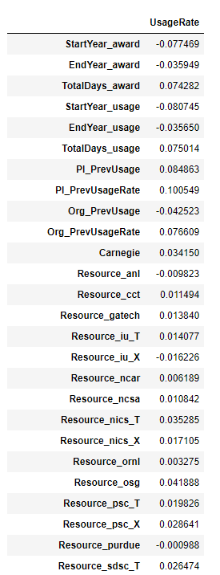
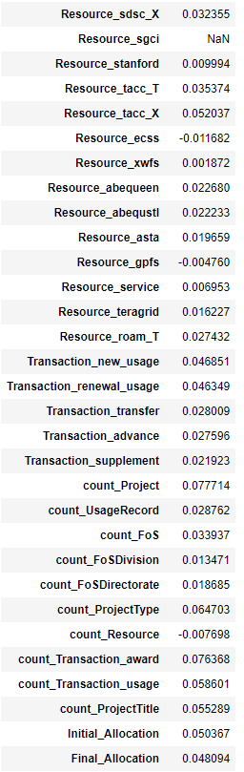
Correlation
Look at correlation between continuous variables and UsageRate

Slide 4
Modelling Process
Specify the columns
Create X and y data sets and split into training and testing sets
Specify model parameters
Fit the model
Generate predictions on train and test sets
Evaluate
If the model is good, predict on actual test file
Notes:
All continuous variables are scaled throughout using a StandardScaler
Data is split into test (30%) and train sets (70%) throughout
UsageRate is target variable throughout

Slide 5

First Model - OLS
It’s simple, easy and where I always start
Columns:
Parameters:
None changed from defaults
Accuracy:

Slide 6
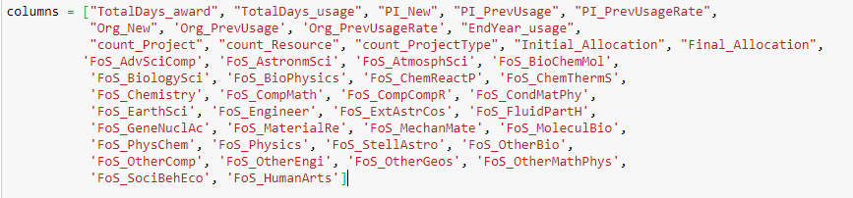


Move to RandomForest
Add in additional columns compared to OLS
Columns:
Parameters:
Accuracy:

Slide 7


Prune RandomForest
Same columns as before, but prune since first attempt appears to suffer from overfitting
Columns:
Parameters:
Accuracy:

Slide 8
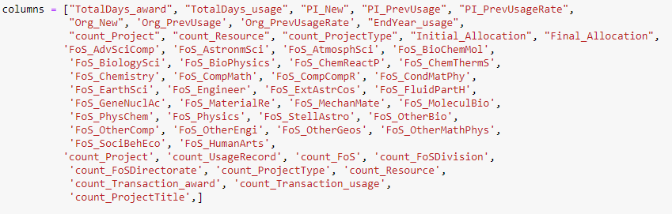


Gradient Boosted Random Forest
Add in more columns from RandomForest models
Columns:
Parameters:
Accuracy:

Slide 9


Categorical XGBoost
Include a few additional categorical variables
Additional:
Organization & Carnegie
Resource_
Parameters:
Accuracy:

Slide 10
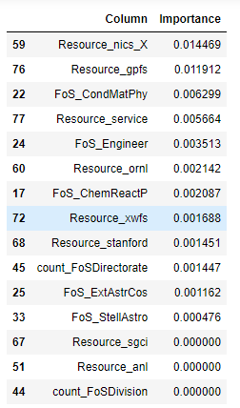
Trimming Categorical XGBoost
Based on feature importance remove the least important variables
Remove all features below 0.01 importance

Slide 11
Second Categorical XGBoost
Based on feature importance remove the least important variables
Remove all features below 0.01 importance and re-run
Continue this process until all the variables have importance of >=0.01

Slide 12
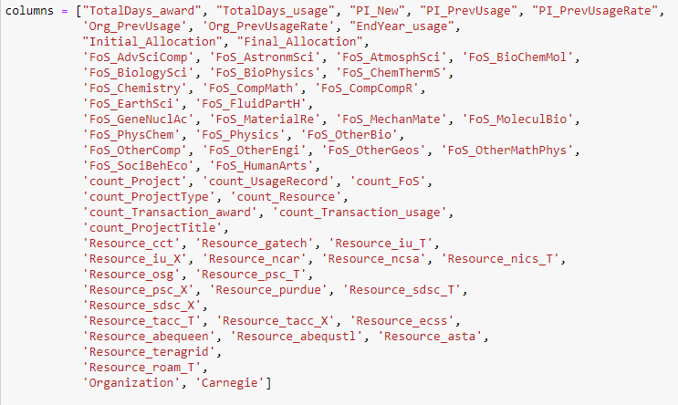


Trimmed Categorical XGBoost
Columns:
Parameters:
Accuracy:

Slide 13
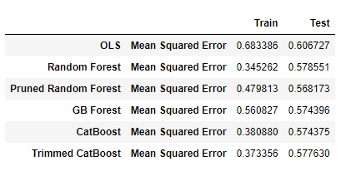
Summary of Accuracy

Slide 14
Findings and Discussion
Model 6 was used to achieve my best results per the Kaggle Contest
Although the more complex methods outperformed the simple linear regression, the fact that the improvement from OLS to XG Boost was relatively small suggests that a more comprehensive analysis with a GLM or GAM may provide very good results
The more complex models look to overfit the data slightly, however, in the end these models provided good results on the true test set. This is likely just the nature of the test set itself in relation to the training set

